Slide 1
Trends of Price and Percent Of Sales
Derek Chao

Slide 2
Description
Delta Faucet Company faucets sold in Home depot and Lowes.
X axis is the week number(1-52)
Left Y axis is the price
Right Y axis is the percent of sales
Percent of Sales means how the sales for a model is compared with the other models sold that week.

Slide 3
Homedepot Models

Slide 4
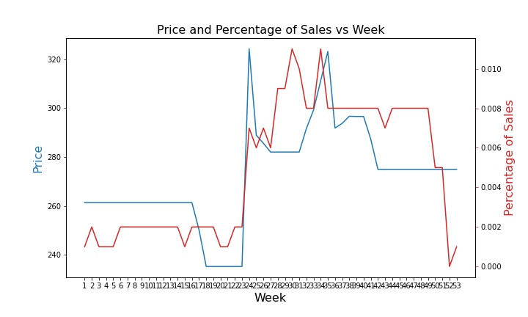
9178T-DST

Slide 5
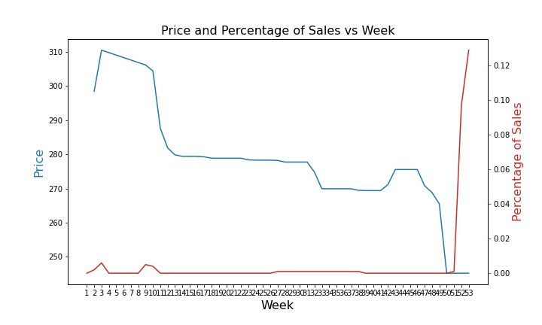
19824LF-SP

Slide 6
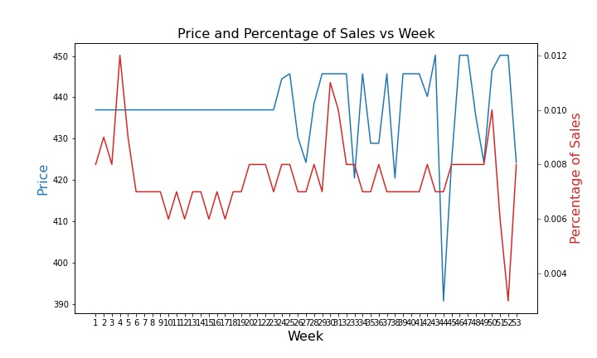
9159-CZ-DST

Slide 7
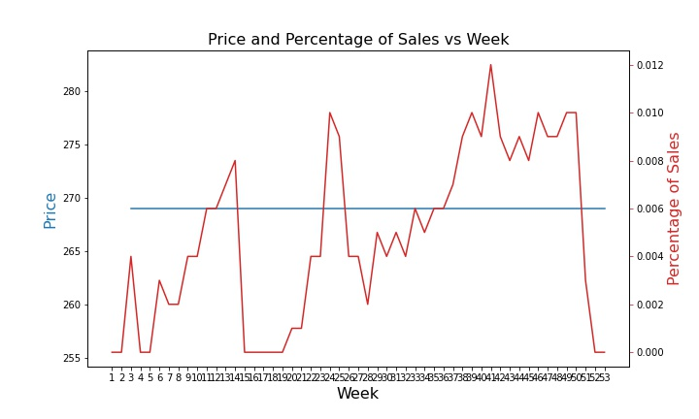
19935L-SPSD-DST

Slide 8
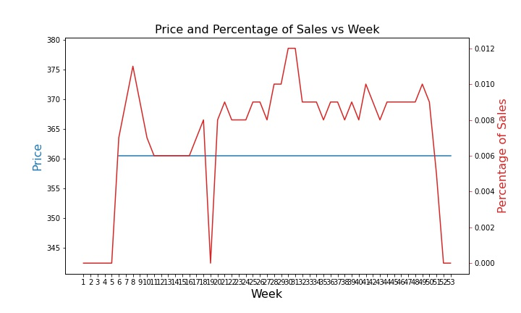
19940TZ-SD-DST

Slide 9
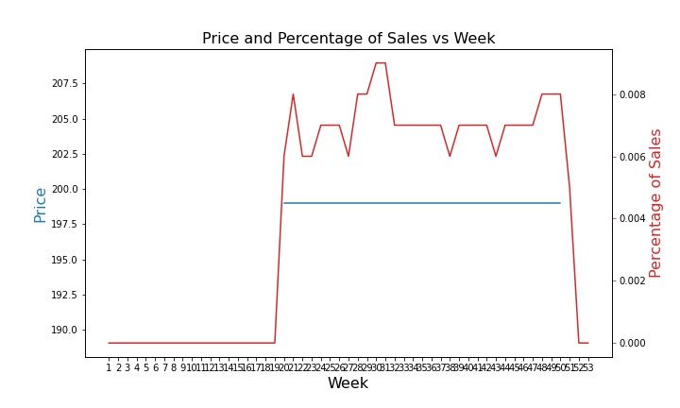
19963-SSSD-DST

Slide 10
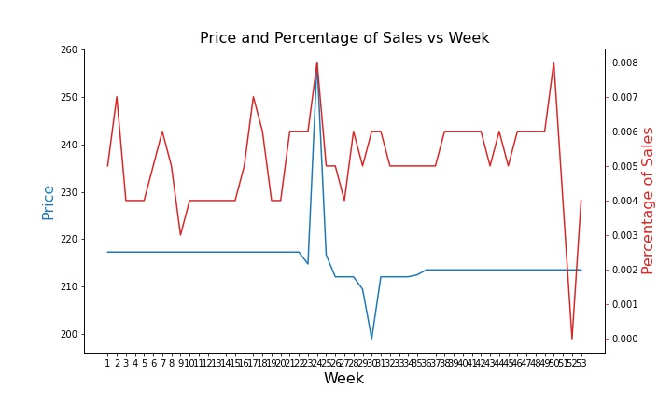
9113-BL-DST

Slide 11
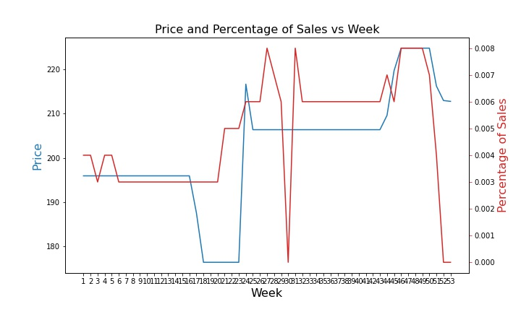
9178-DST

Slide 12
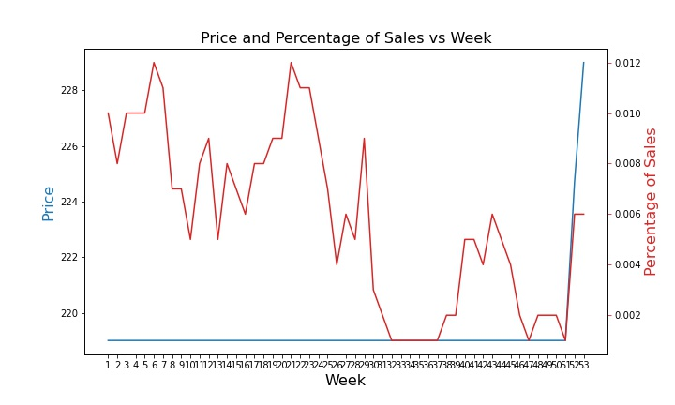
19780Z-BLSD-DST

Slide 13
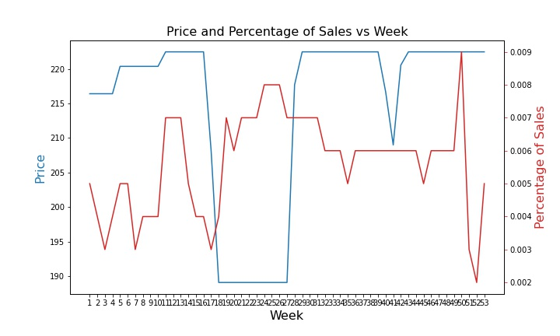
16970-SSSD-DST

Slide 14
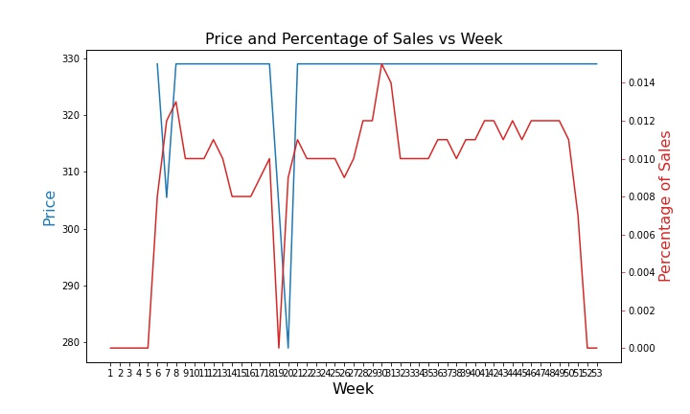
19940TZ-SPSD-DST

Slide 15
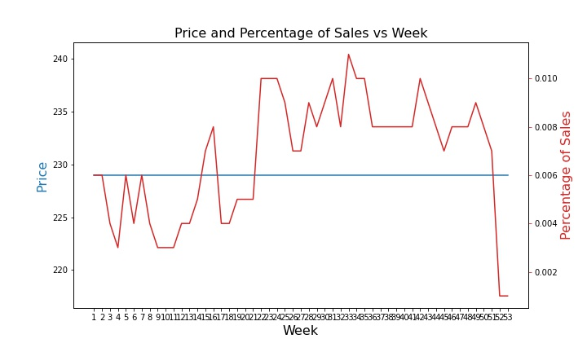
19978Z-RB-DST

Slide 16
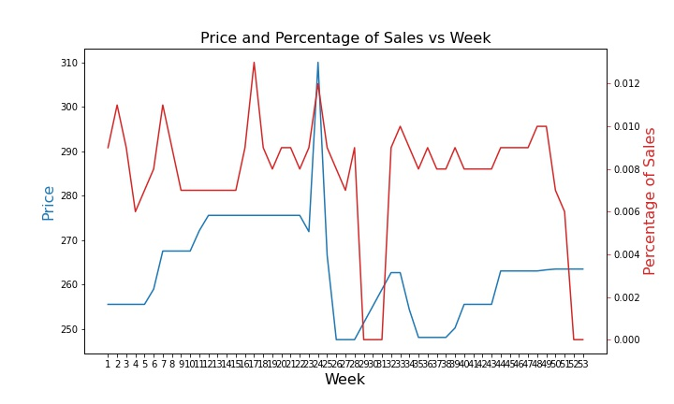
9113-RB-DST

Slide 17
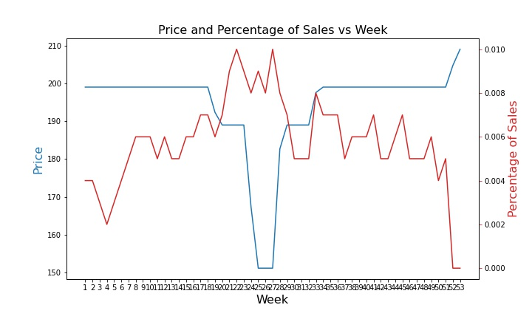
19912Z-SSSD-DST

Slide 18
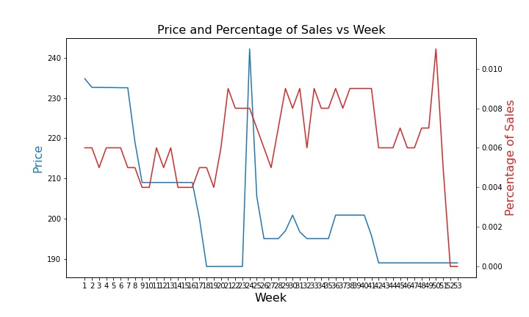
9178-AR-DST

Slide 19
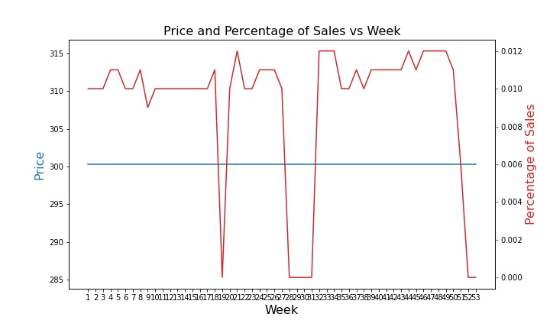
9181-DST

Slide 20
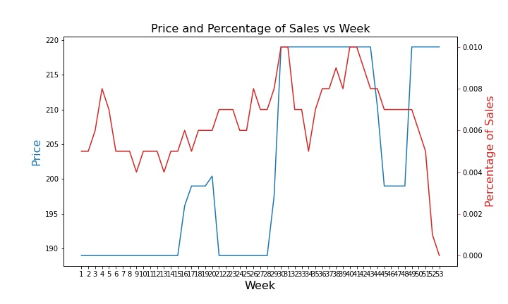
19962Z-SSSD-DST

Slide 21
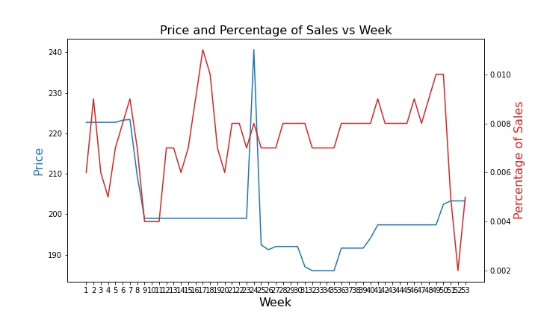
9113-AR-DST

Slide 22
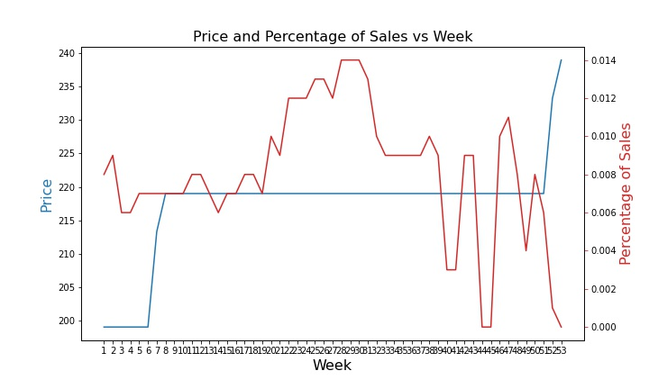
19875Z-SPSD-DST

Slide 23
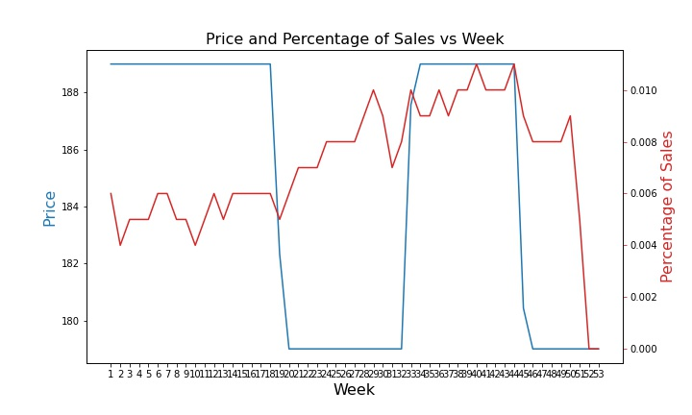
19978Z-SS-DST

Slide 24
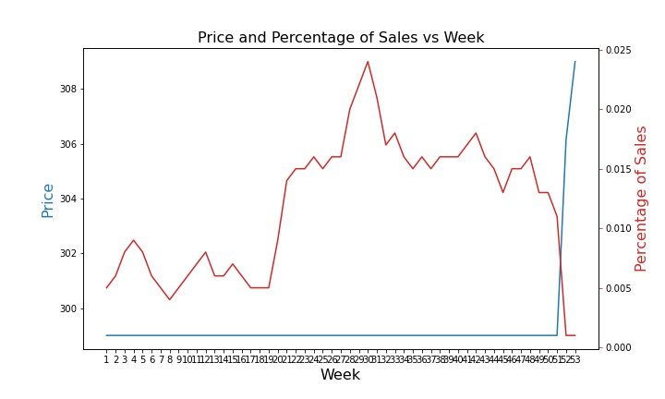
19962TZ-SSSD-DST

Slide 25
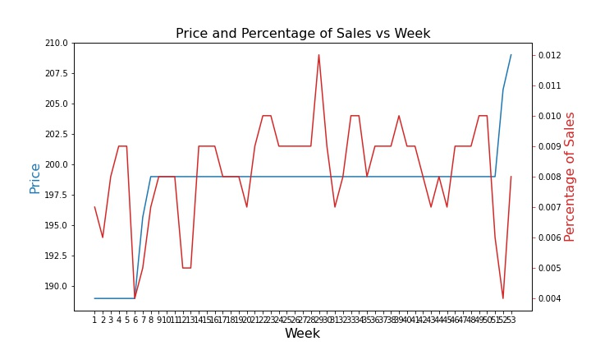
19780Z-SPSD-DST

Slide 26
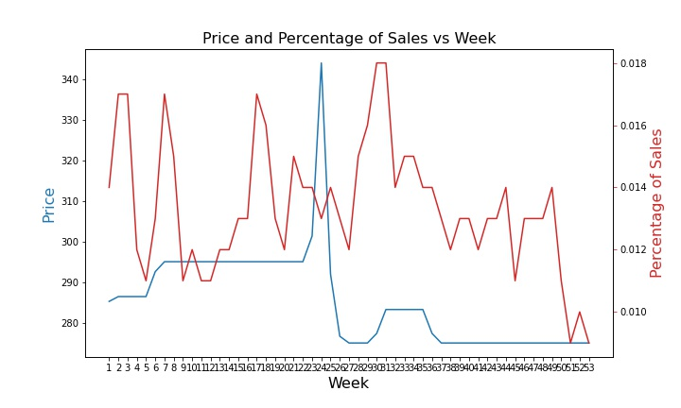
9113T-AR-DST

Slide 27
Lowes

Slide 28
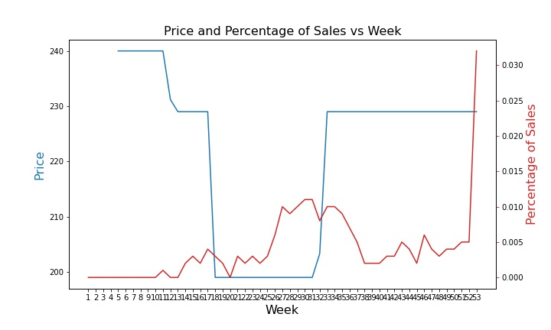
19998Z-BLSD-DST

Slide 29
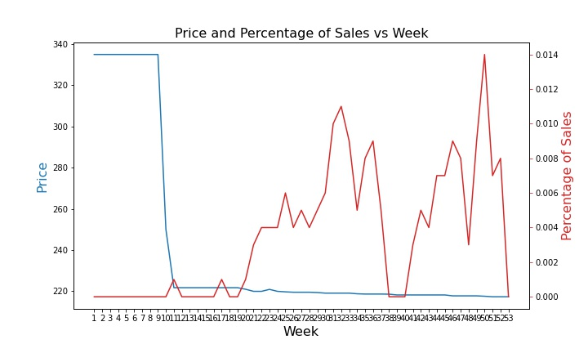
19824LF

Slide 30
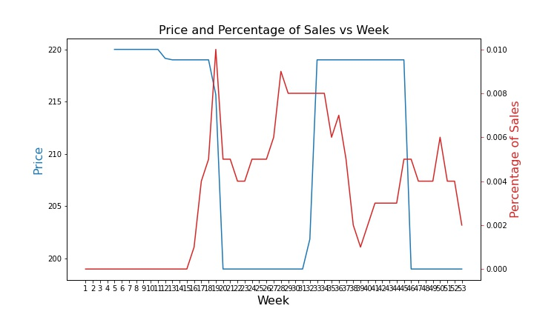
19830Z-SPSD-DST

Slide 31
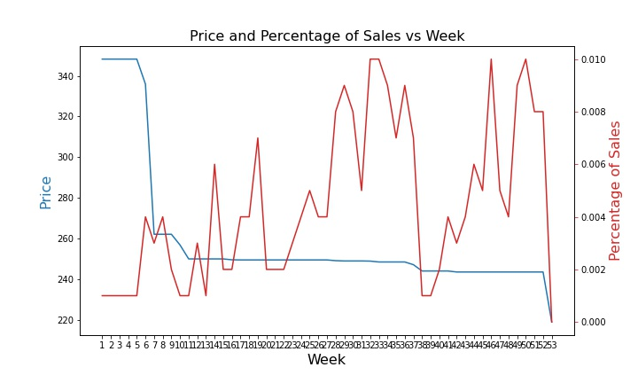
19802Z-SP-DST

Slide 32
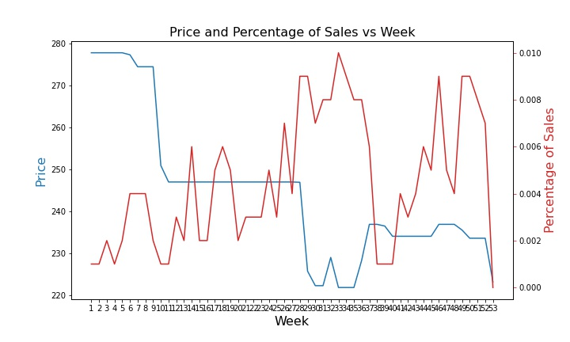
19802Z-BL-DST

Slide 33
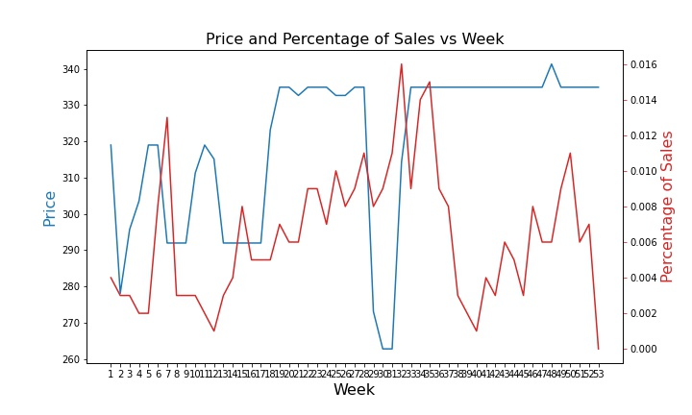
', '19957Z-CZSD-DST',

Slide 34
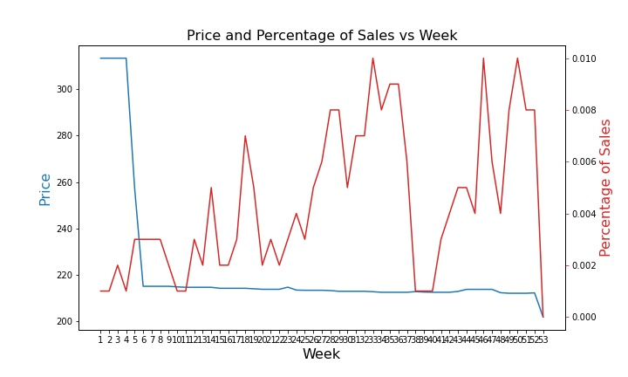
19802Z-DST

Slide 35
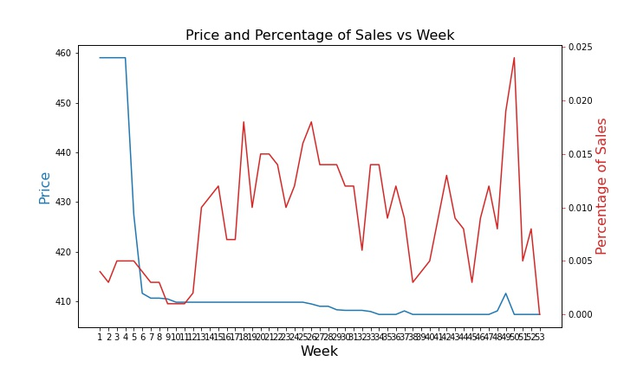
19802TZ-CZ-DST

Slide 36
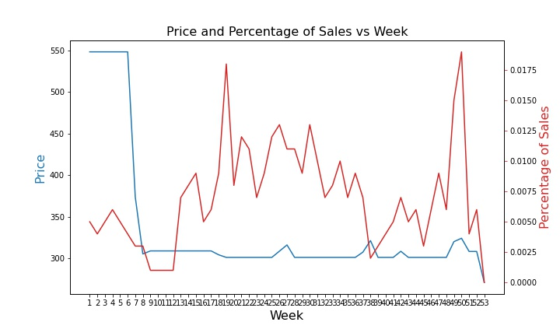
19802TZ-SP-DST

Slide 37
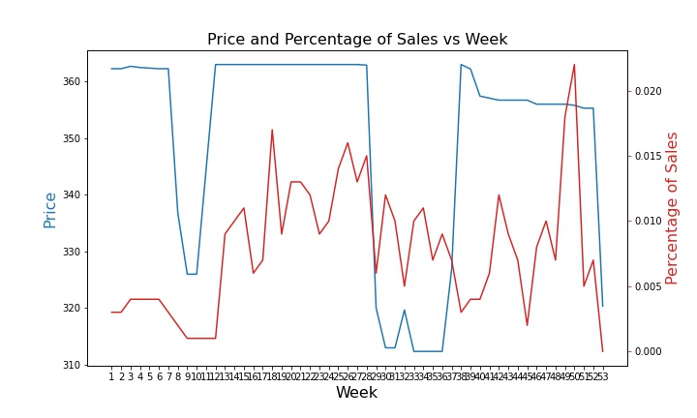
19802TZ-BL-DST

Slide 38
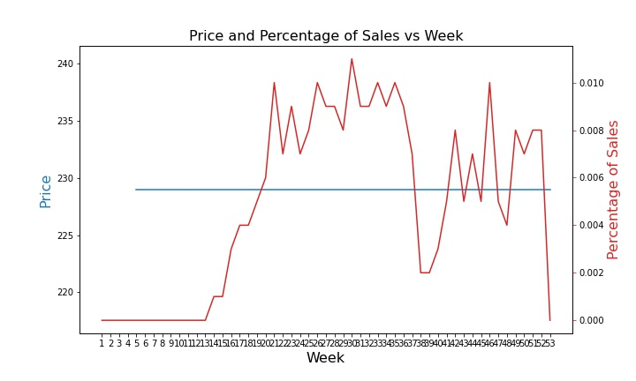
19756Z-KSSD-DST

Slide 39
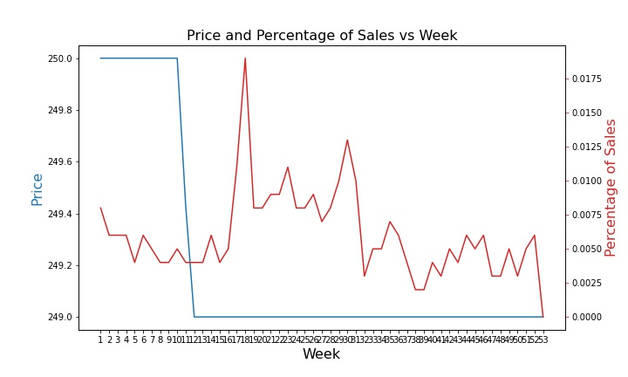
19933L-SPSD-DST

Slide 40
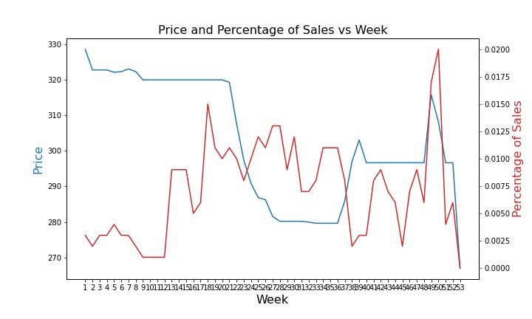
19802TZ-DST

Slide 41
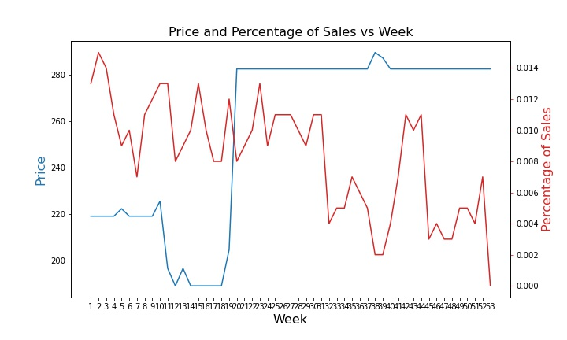
19933-BLSD-DST

Slide 42
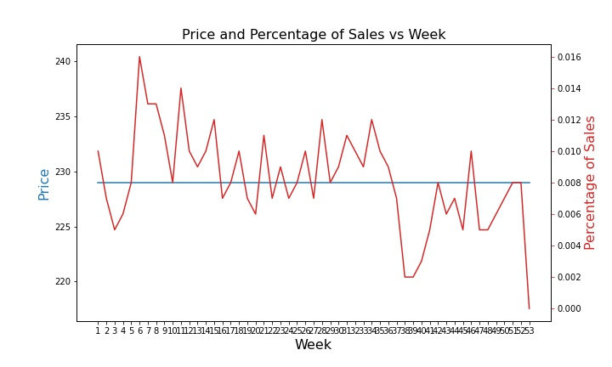
19756Z-BLSD-DST

Slide 43
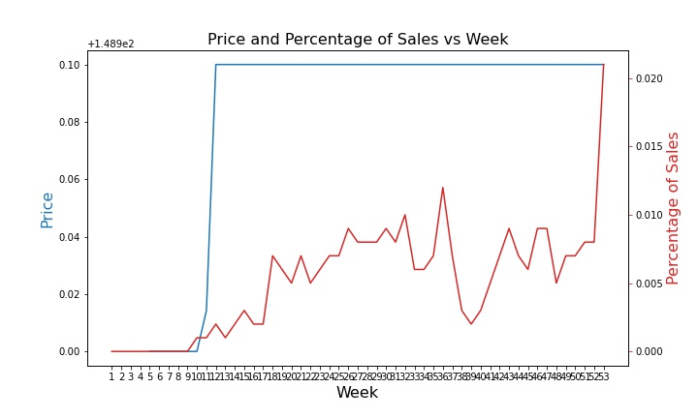
19949Z-SD-DST

Slide 44
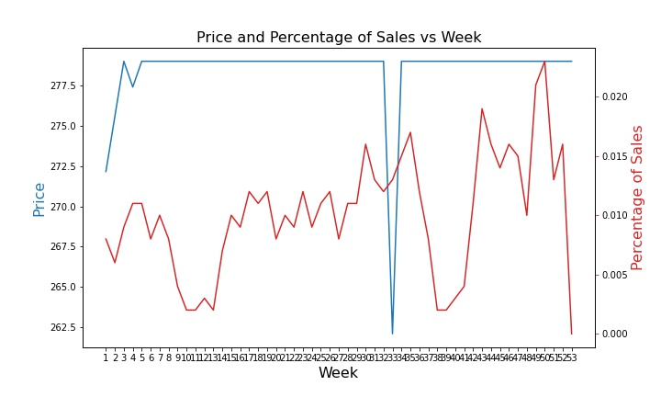
19933-CZSD-DST

Slide 45
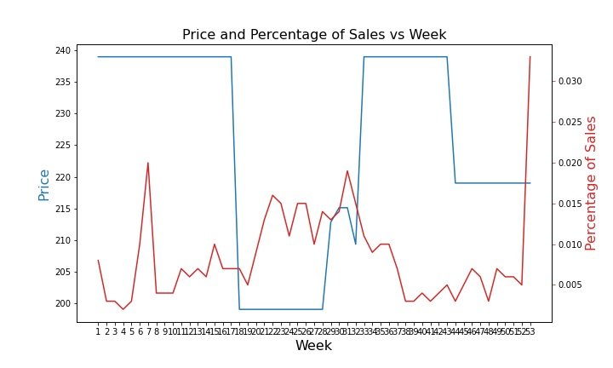
19957Z-SPSD-DST

Slide 46
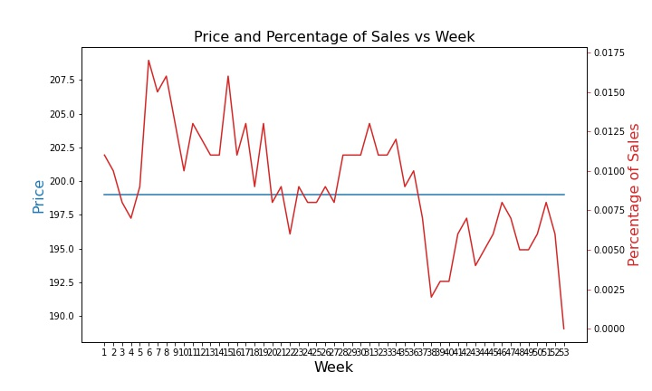
19756Z-SPSD-DST

Slide 47
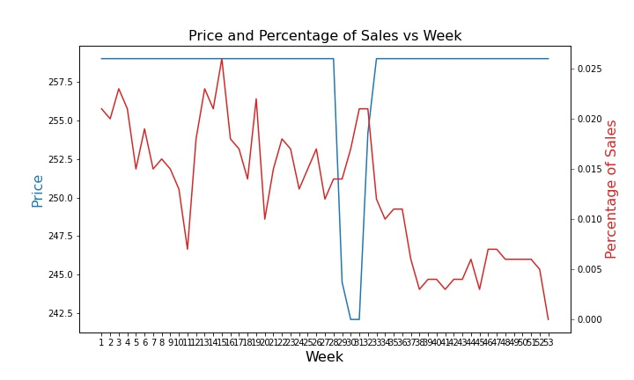
19957Z-RBSD-DST

Slide 48
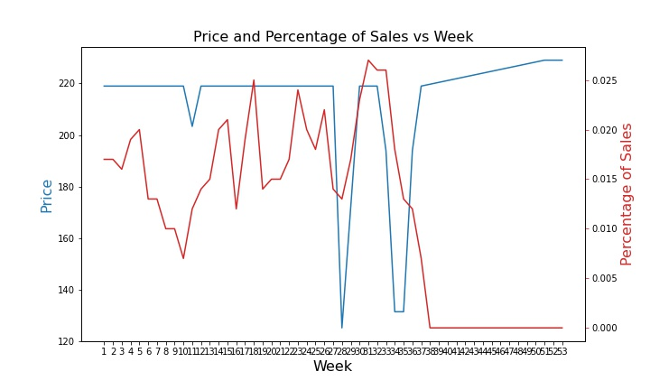
19933-SD-DST

Slide 49
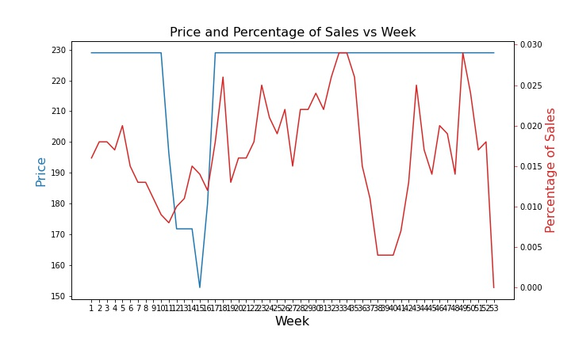
19933-SPSD-DST

Slide 50
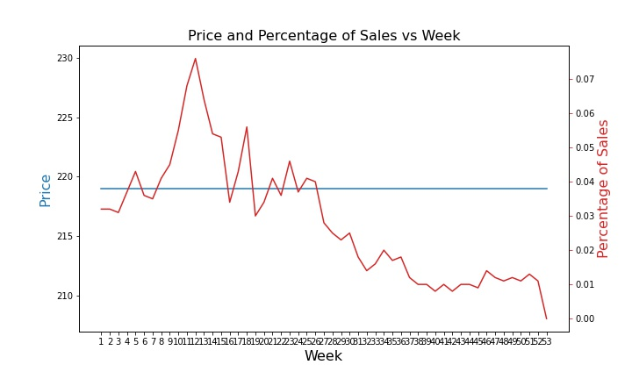
19922Z-KSSD-DST

Slide 51
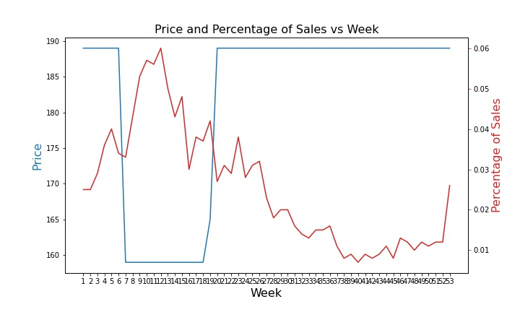
19922Z-SSSD-DST

Slide 52
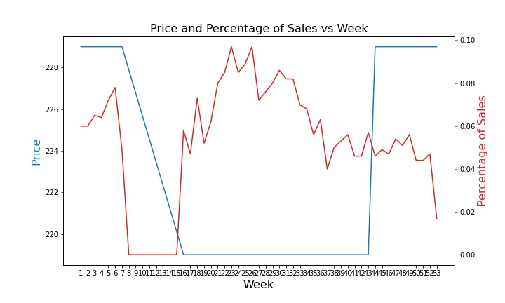
19949Z-RBSD-DST,

Slide 53
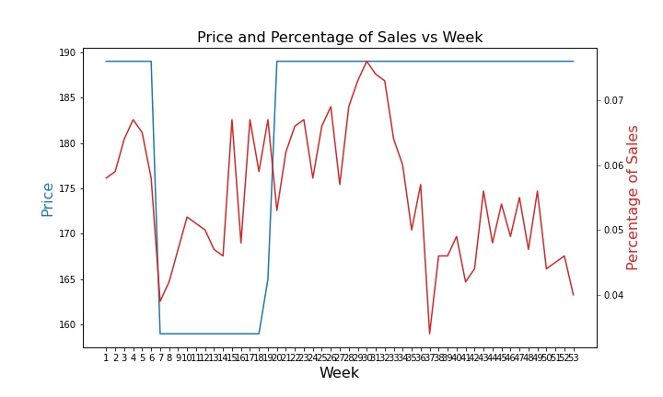
19949Z-SSSD-DST

